Slide 1
X 92
X95

Slide 2
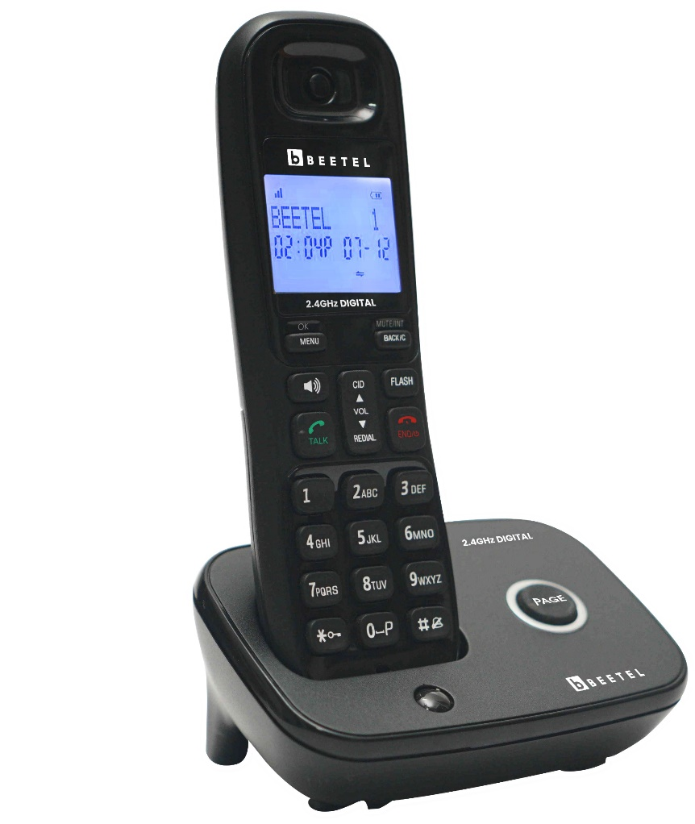
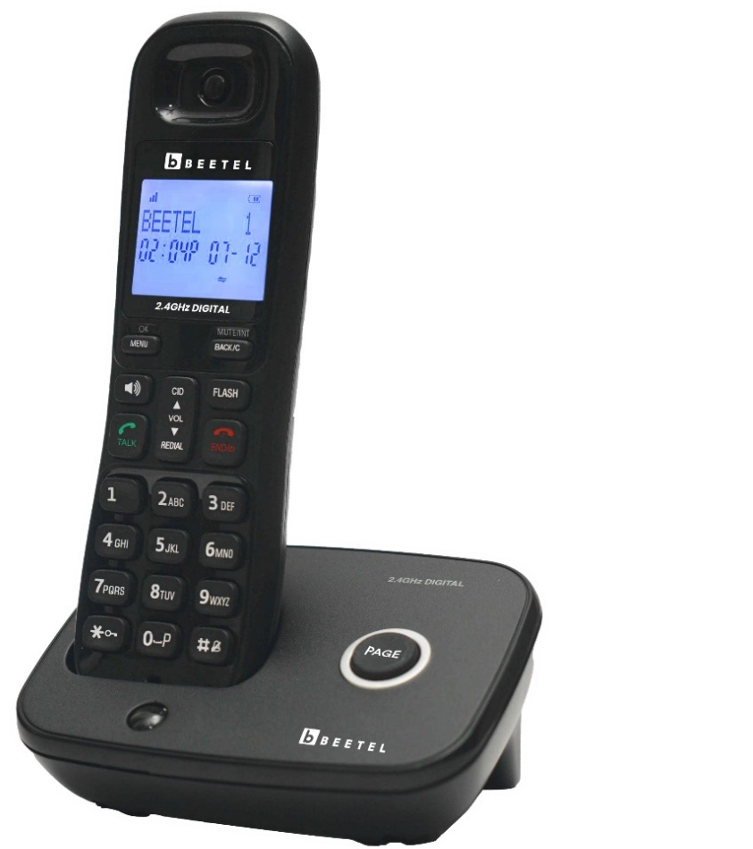
Caller ID Cordless Telephone Model: X92
Beetel.in

Slide 3
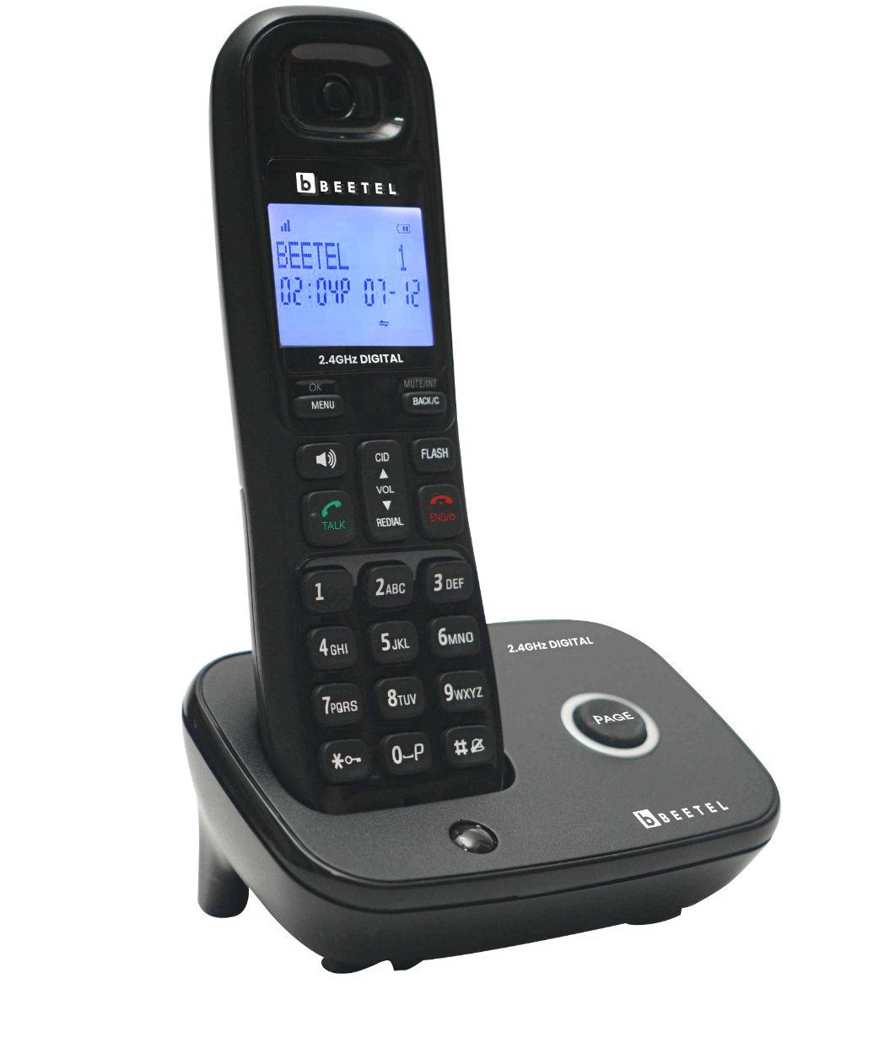
M O D E L X 92
Cordless Phones
2.4GHz Digital Technology Cordless
Dual Mode DTMF / FSK Caller ID System Compatible
1-Line Dot Matrix & 1-Line 7-Segment LCD Display
Blue-White Backlit LCD Display
Illuminated Keypad
50 Incoming Calls Memory
Phone Book to store 100 Nos. with Name
Two-way Speakerphone with Adjustable Volume
5 -Step Receive Volume Control
5 -Ring Tones & 5 -Polyphonic Ring Tones at
Handset with Adjustable Volume
6 -Step Ringer Volume Control at Handset with “OFF”
Handset - ON / OFF
Auto Answer - ON / OFF
Handset Keypad - Lock / Unlock
Alarm Function
Handset Locator ( Paging from Base Unit to Handset)
Tone / Pulse dialing mode ( Programmable )
Last Number Redial
Mute Function
Out of Range Warning Tone
Low Battery Warning Tone
Battery Charging Level Indicator on Handset
Baby Call Function
In-Use LED in Base Unit
Colour Available :
TEC Certified (ER No. TEC12672301)
MRP- Rs. 3499

Slide 4
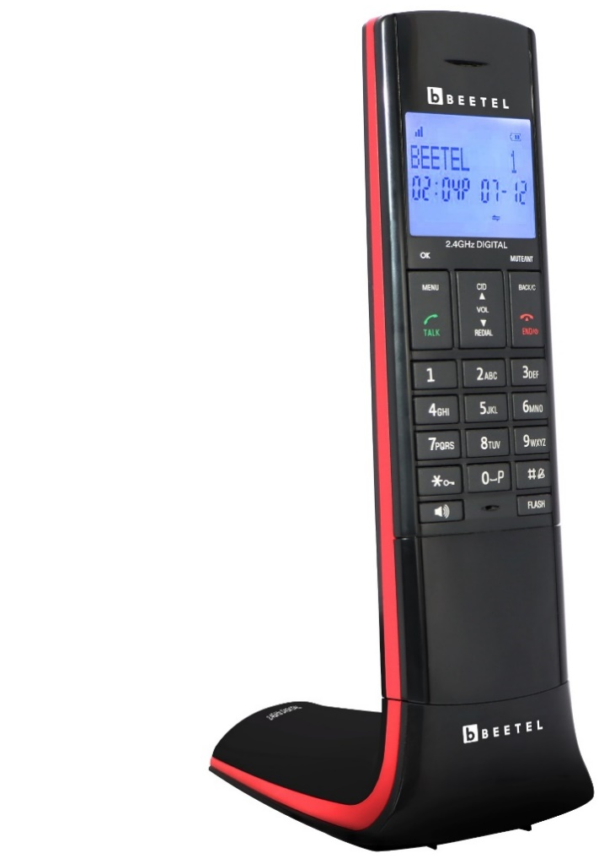
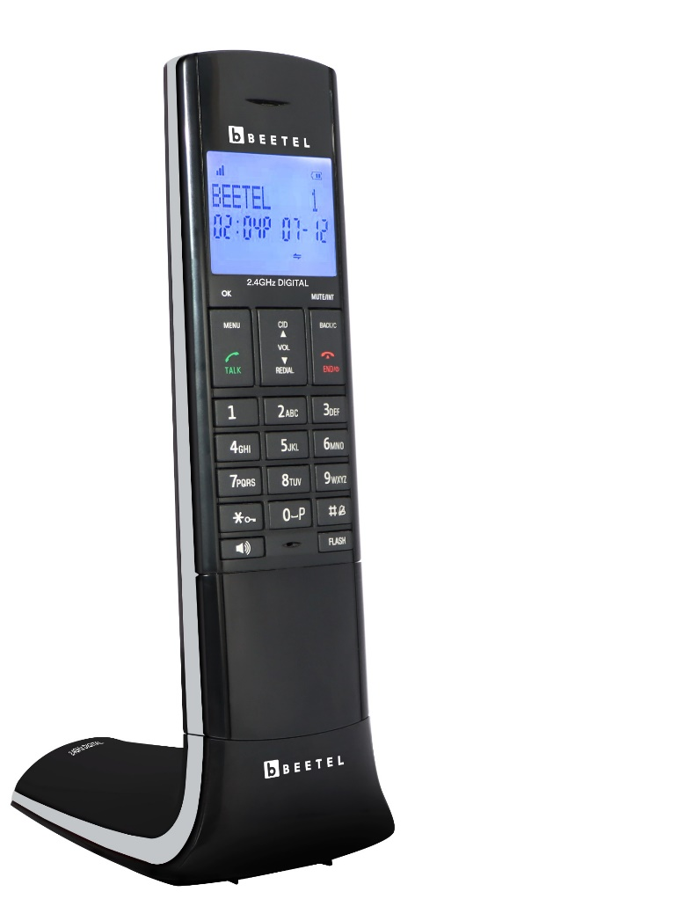
Caller ID Cordless Telephone Model: X95
Beetel.in

Slide 5
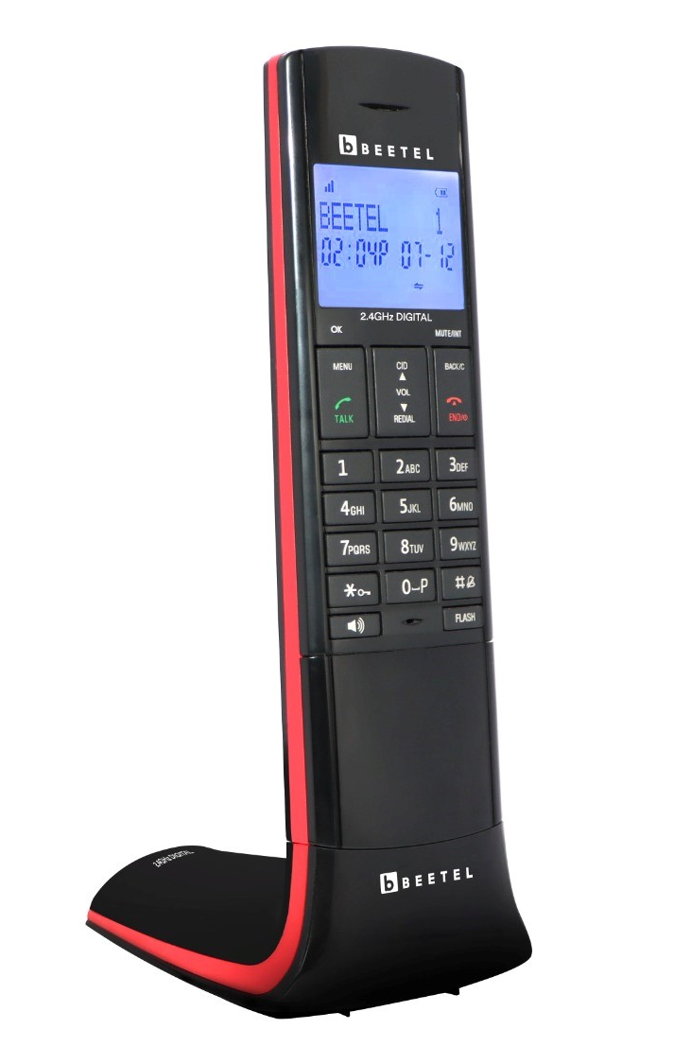
M O D E L X 95
Cordless Phones
2.4GHz Digital Technology Cordless
Designer Cordless Phone
Dual Mode DTMF / FSK Caller ID System Compatible
1-Line Dot Matrix & 1-Line 7-Segment LCD Display
Blue-White Backlit LCD Display
50 Incoming Calls Memory
Phone Book to store 100 Nos. with Name
Two-way Speakerphone with Adjustable Volume
5 -Step Receive Volume Control
5 -Ring Tones & 5 -Polyphonic Ring Tones at
Handset with Adjustable Volume
6 -Step Ringer Volume Control at Handset with “OFF”
Handset - ON / OFF
Auto Answer - ON / OFF
Handset Keypad - Lock / Unlock
Alarm Function
Handset Locator ( Paging from Base Unit to Handset)
Tone / Pulse dialing mode ( Programmable )
Last Number Redial
Mute Function
Out of Range Warning Tone
Low Battery Warning Tone
Battery Charging Level Indicator on Handset
Baby Call Function
Colour Avilable: Red/Black, Grey/Black, Yellow/Black
TEC Certified (ER No. TEC12672301)
MRP- Rs. 3699

Slide 6
Thank You

